Slide 1
Predicting daily health with a wearable tracker
Tracy Duvall
March 12, 2025

Slide 2
Two attempts
Goal: Create an app to predict ME/CFS sufferers’ health thoughout the day using data available upon waking
Piloting with my personal data to test likelihood of general applicability
First version completed in 2023
  The data covered a 3.5-year period of mostly severe ME/CFS with brief episodes of moderate or mild symptoms
Redone recently with data from a more capable tracker
  My health swung from mild to quasi-severe ME/CFS (and PASC) during this 10-month period
  However, improved treatments have reduced the clarity of PEM for me
None of the many models generated provides a highly reliable predictor

Slide 3
Round 1: Methods
Tested how well resting heart rate and heart-rate variability predict PEM
  Restricted the study to scores that an app could use to quickly produce a prediction
  Used Garmin’s Stress Score average upon waking as a proxy for HRV
  Overfitted using the full dataset on a single subject (me) to determine the best-case scenario
Extensive data preparation:
  Imputation
  Moving averages of baseline values
  Percentage change from recent baseline
  Difference from recent baseline
  ROSE data-balancing
Multiple outcomes tested
  PEM days
  Days adjacent to full PEM
  Index of symptoms that worsen during PEM, for regression (not useful)

Slide 4
Round 1: Results
Assessed multiple sets of predictors in multiple models using cross-validation (in R)
  SVM
  Random forest
  K nearest neighbors
  XGBoost with Bayesian parameter estimation
  Logistic regression (strongest)
    PEM-adjacent days
      With predictors: (Stress – running avg) & (RHR – running avg)
        F1 0.33, AUC 0.56, recall 0.495, specificity 0.624
      With predictor: Stress – running avg
        F1 0.31, AUC 0.51, recall 0.61, specificity 0.41
    PEM days
      With predictors: (Stress – running avg) & (RHR / running avg)
      F1 0.32, AUC 0.58, but recall 0.29
Conclusion: They predicted poorly

Slide 5
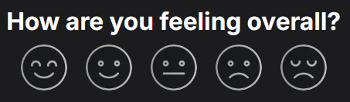
Round 2: Method
6 predictors available upon waking with Garmin Venu 3
  Sleep score, resting heart rate, body battery, respiration rate, skin temperature change, average HRV status
3 outcomes recorded at bedtime
  Active calories (regression)
  Daily rating on 1-5 scale from Solve Together (regression and ordinal classification)
  PEM (binary classification)
Two types of model for each, in Python
  Neural network, using Keras
  Gradient boosted trees (scikit-learn’s implementation or, for ordinal classification, LGBMOrdinal)
  Tested wide range of hyperparameters for each
    Also, tested alternate models and methods of data prep
Data prep
  In the final version of the best model, the mean of the previous 2 weeks was subtracted from the observed values, to adjust for changes in baseline values
  For classification models, rebalanced data
    Ordinal: Few 2s and 4s, no 5s
    Binary: Few PEM days
  Split into training, validation, and test sets for neural networks and into training and test sets for trees

Slide 6
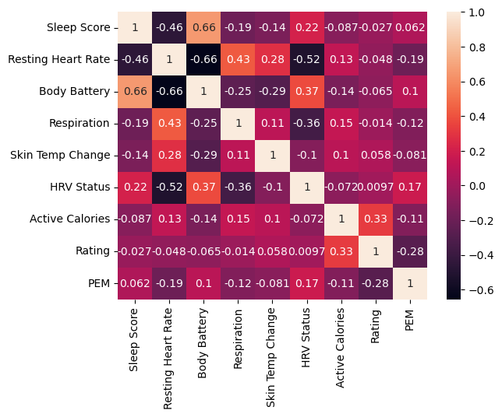
Round 2: EDA

Slide 7
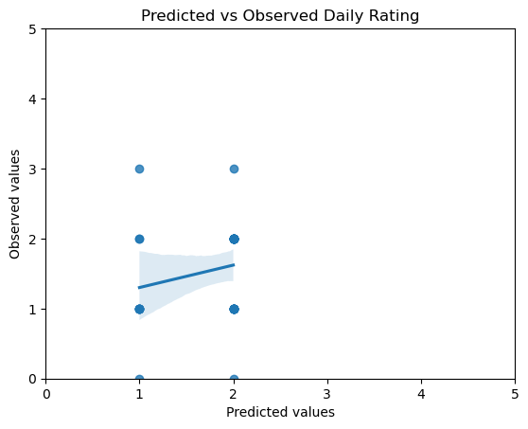
Round 2: Results
Strongest model: neural network performing ordinal classification of daily ratings
Overall accuracy of strongest model (neural network
  Exact: 53.5% of days
  Within 1: 93.9% of days
Average class-accuracy: 0.348
Correlation between predicted and observed ratings: 0.272
F1: 0.314
Binary prediction of whether a day will be bad or not-bad (0-1 vs 1-2 ratings, respectively)
  Correct on only 44% of the bad days but on 70% of the not-bad ones.
  If these occur equally frequently, the model will predict correctly on 57% of days
  If weighted by the frequency of ratings in the overall dataset, the bad/not-bad accuracy falls to 52%
In sum, this model is weak but still outperforms its components, on which many people with ME currently rely. For example, the correlation between predictions and observations in the test set is 0.272 – more than 0.2 higher than the correlation between the daily ratings and any of the predictors.

Slide 8
Why so weak?
Inaccurate or unreliable measurements
  Predictors (Garmin) and outcomes (me)
Many other factors affect the predictors
  Infections
  Pizza at night
My relatively successful treatments might mask signals that would be clearer among the general population.
  Both predictors and outcomes

